Slide 1



Preventative Safety Metrics
Roy E. Sturgill, Jr. P.E., KTC
Jon Lam, KYTC District 3 Employee Safety
Danny McCreary, KYTC OHRM ESH, Safety Administrator
Gabriel B. Dadi, P.E., Ph.D.

Slide 2
OSHA Injury Rates
Not strictly field focused!
KYTC Goal: 5.0

Slide 3
KYTC Maintenance Safety Snapshot
>15% RIR for maintenance employees
Averaged 6 injuries per week in 2015
Safety Programs Past Focus
  Lagging indicators, no leading indicators
What can we do? What should we do?

Slide 4



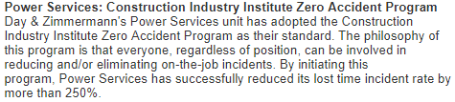







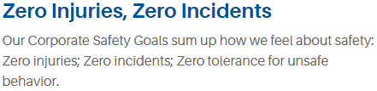





Leaders in Safety- Their Goal…
Zero Injuries
Why Not Us?

Slide 5
Background on Safety Indicators
Lagging (TRIR, DART, etc.)
  Required by law
  Gives post-incident feedback
  Limited in action
Leading (Training, Near Misses, Job Briefings, etc.)
  Identify and close gaps in safety management
  Preventative → allows for actions to avoid lagging indicators
Proactive Safety vs. Reactive Safety

Slide 6
Current Effort
Developing a preventative safety metric scoring tool that provides actionable guidance on issues that may potentially lead to an incident
Why: What gets measured, gets improved
Creates a proactive safety management tool
Assesses the existence and the degree of safety procedures

Slide 7
What can KYTC score?
Completion of daily job briefing
Completion of semi-monthly crew safety talks
Training/certification attainment
Completion of TC25-162 (Supervisor’s Injury Investigation)
Number of Safety Risk Reports
Participation in Go365

Slide 8
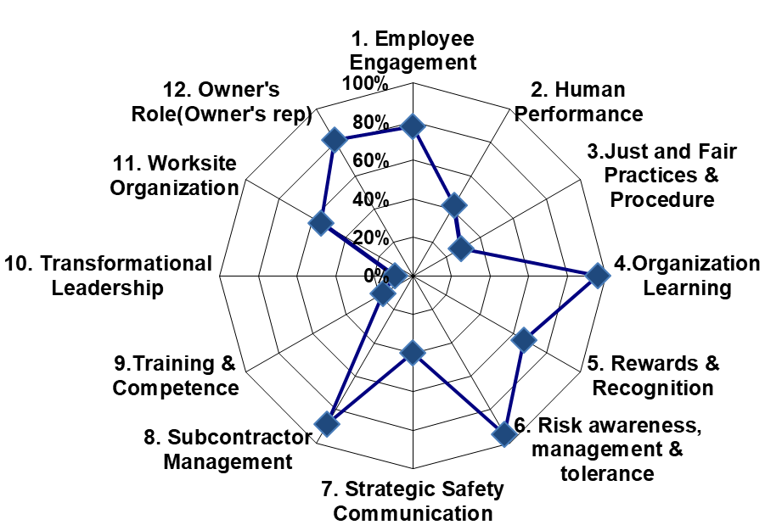
Sample Scoring Tool from CII
Notes:
Use multiple points, if necessary.

Slide 9
Recent Effort
Development of a Pre-Task Safety Talk Tool
  Injury Data (2005 – 2015)
  Total number of claims (3,876)
  Classified according to NCCI code
  Information included:
    Event date, time, and location
    NCCI Cause description
    Incident description
    Claimant age, title, and other info.

Slide 11
Categorized Incident to Field Operations Guide
Concrete repair & bridge maintenance
Equipment maintenance
Guardrail maintenance
Litter and Debris removal
Mowing
Pipe/ Drain clearing and replacement
Road & Shoulder repairs
Sign inventory & replacement
Snow and Ice removal
Tree & Brush trimming
Notes:
Use brief bullets and discuss details verbally.

Slide 12
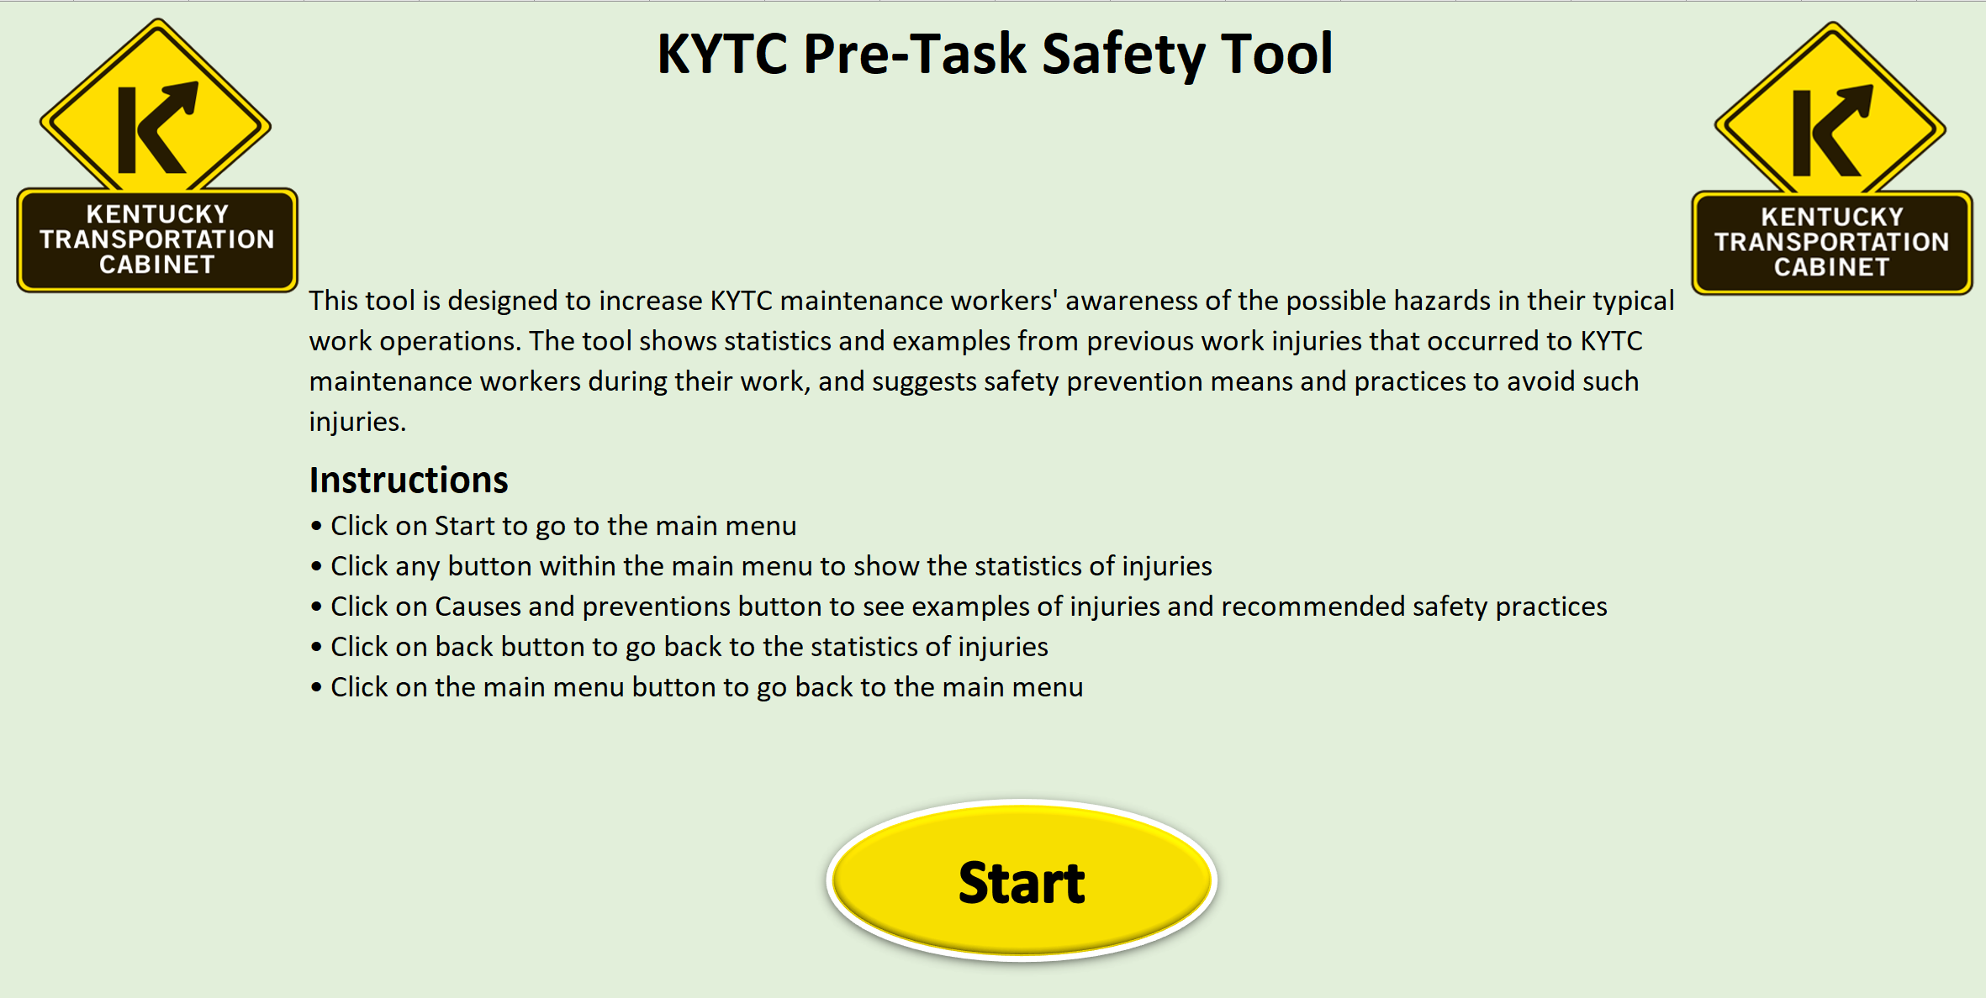

Slide 13
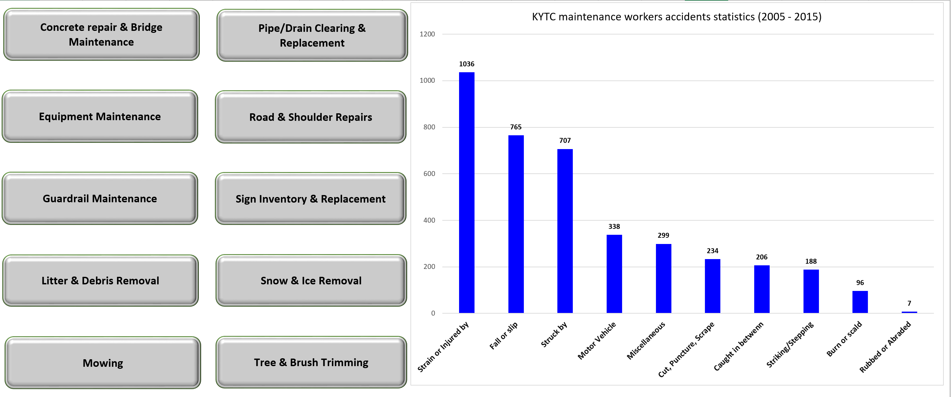

Slide 14
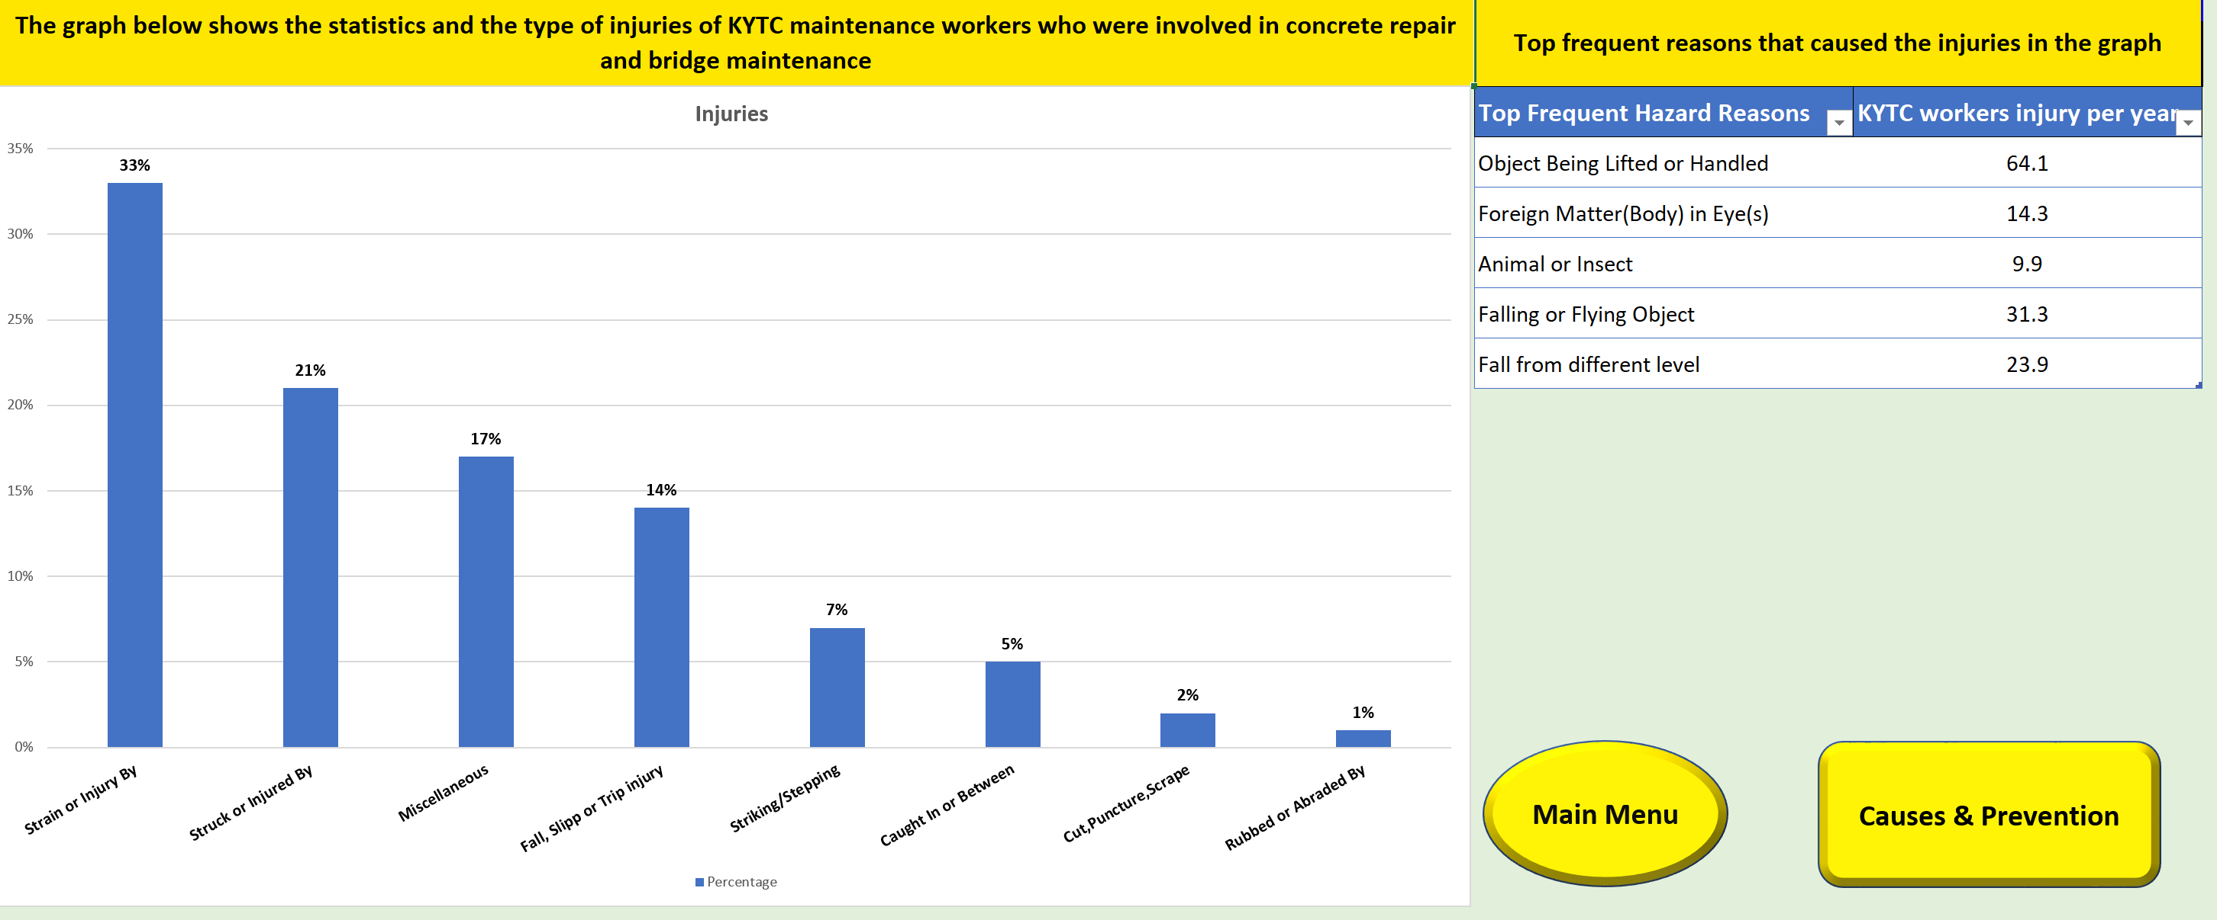

Slide 15
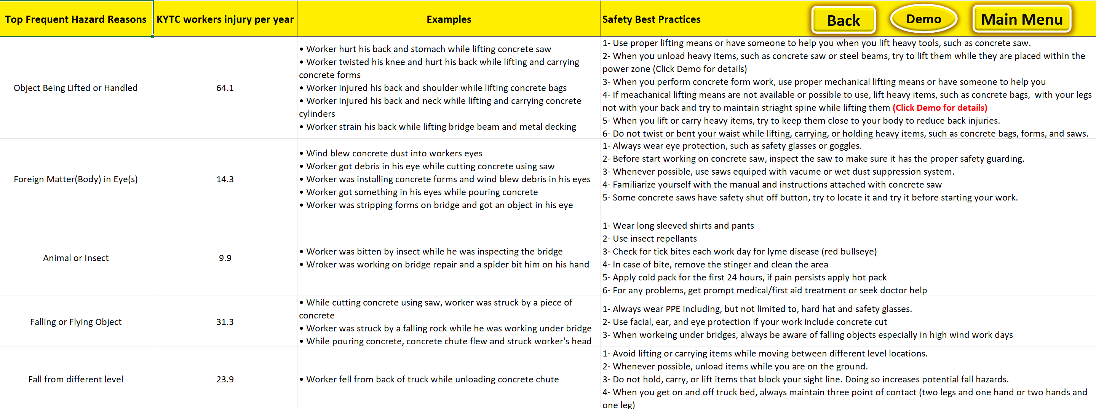

Slide 16
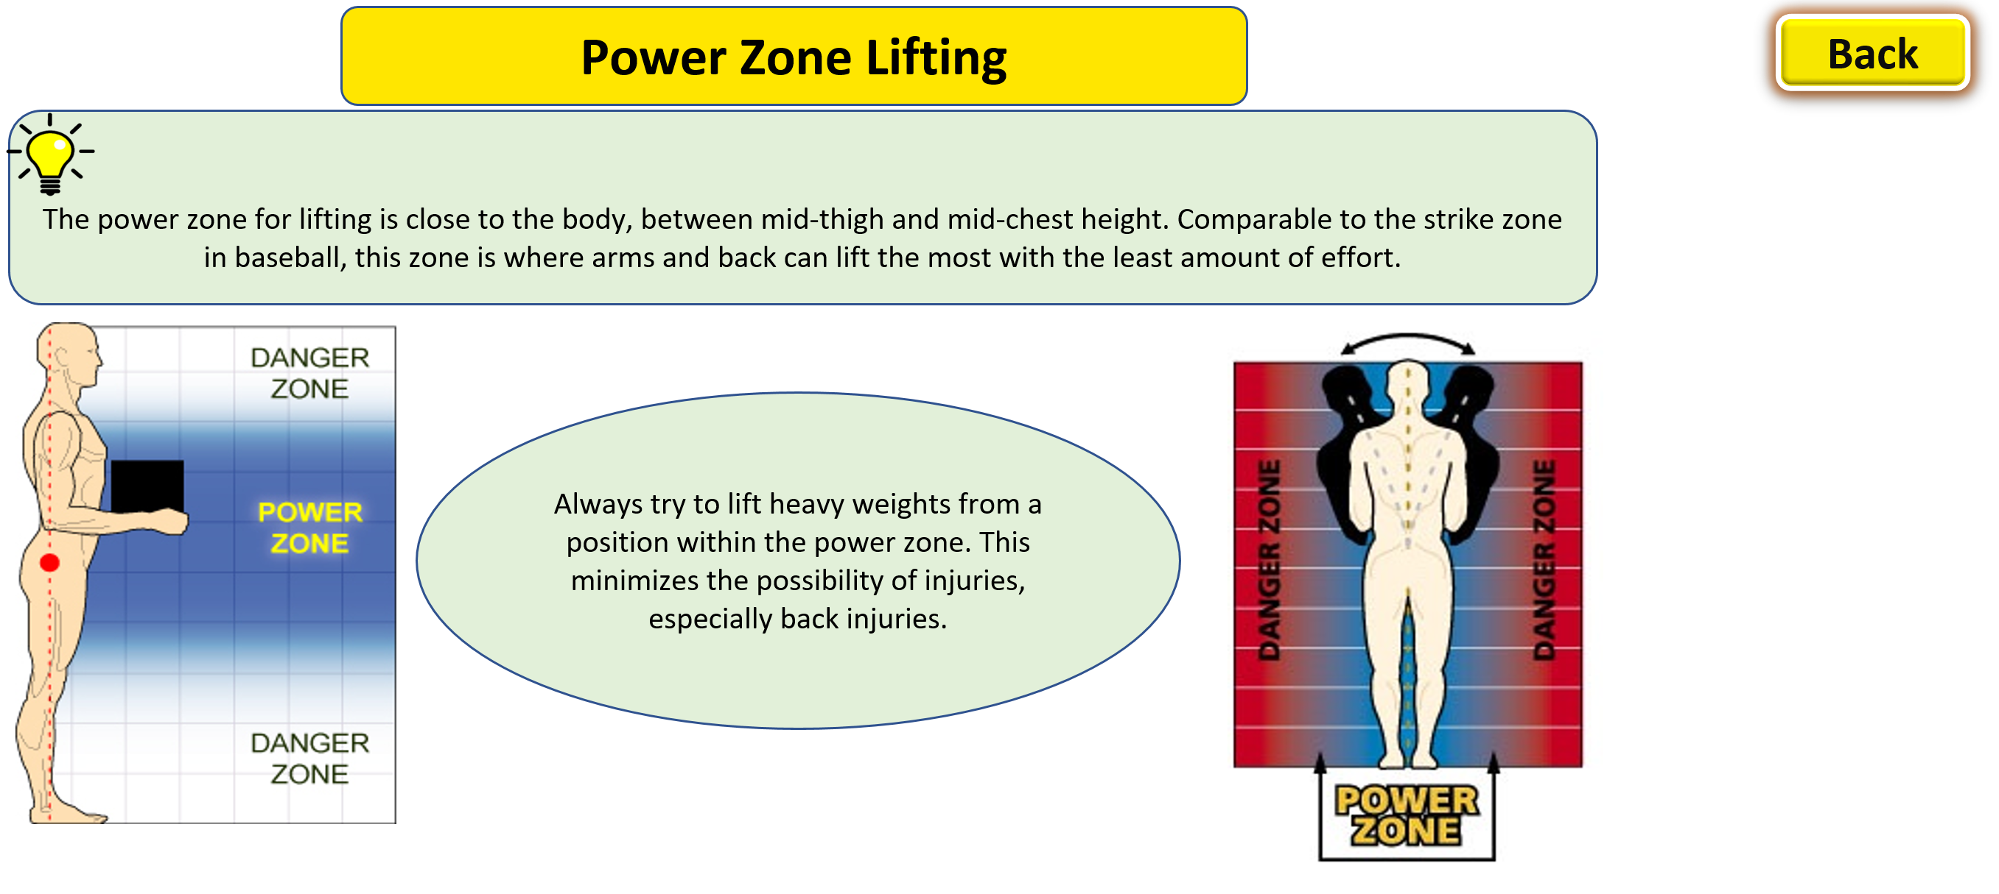

Slide 17
Safety is Everyone’s Responsibility.

